Slide 1





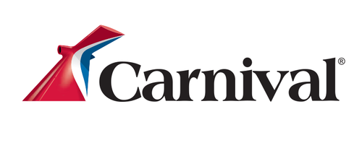

GumGum drives consideration for a travel brand
Objective
A cruise ship brand looked to GumGum to help shift perception and increase consideration amongst their key audience of A25-54
.49%
CTR
4x greater than the industry benchmark of 0.12%
Update image based on Industry
GumGum Strategy
GumGum used it’s contextual intelligence technology, Verity™, paired with the In-Screen Expandable Video and In-Screen Scroll custom creative units to surround content related to vacations, beach trips, summer activities and family trips in order to entice users to click the ads and visit the brands site.
93.89%
Viewability Rate
~1.5x greater than the industry benchmark of 60.6%
Sample Partners within Travel:
69.76%
Video Completion Rate
~1.2x greater than GumGum’s benchmark of 60%

